Slide 1
Suyash Chaudhary

Slide 2
Web Application Testing

Slide 3
Website Name - Dukaan (LINK)
Host Address
Issuer
65.20.70.207
issuer=C = AT, O = ZeroSSL, CN = ZeroSSL RSA Domain Secure Site CA
Subject Name
Target Server
mydukaan.io
nginx/1.25.3

Slide 4
Table of contents
01
02
03
04
05
06
Fingerprint Web Server
Test File Extensions Handling for Sensitive Information
Test HTTP Strict Transport Security
Enumerate Applications on Webserver
Testing for Weak Transport Layer Security
Content Security Policy

Slide 5
01
Fingerprint Web Server

Slide 6

Server Used - nginx/1.25.3
Severity - HIGH
Plugin ID 114207
Description
According to its Server response header, the installed version of nginx is 1.25.x prior to 1.25.4. It is, therefore, affected.

Slide 7
Server used - nginx/1.25.3 Tool used- Nmap
Vulnerability found
- A NULL pointer dereference in HTTP/3. (CVE-2024-24989)
- A Use-after-free in HTTP/3. (CVE-2024-24990)
Vulnerable: 1.25.3
Solution
Upgrade to nginx version 1.25.4 or later.

Slide 8
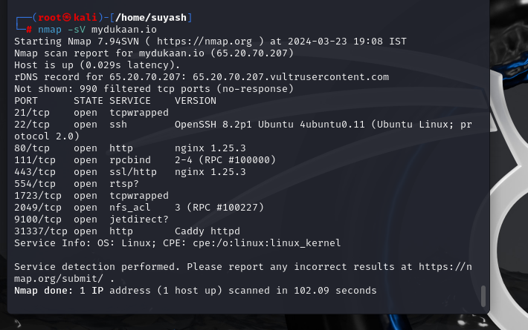
Evidence
CMD - Nmap -sV mydukaan.io

Slide 9
References
https://nginx.org/en/security_advisories.html
https://www.nginx.com/blog/updating-nginx-for-the-vulnerabilities-in-the-http-3-module/
https://www.tenable.com/plugins/was/114207
https://nvd.nist.gov/vuln/detail/CVE-2024-24989
https://nvd.nist.gov/vuln/detail/CVE-2024-24990

Slide 10
02
Test File Extensions Handling for Sensitive Information

Slide 11

Description
The fallout could be as minor as a local pathname being disclosed in a stack trace, allowing a malicious actor to improve their knowledge of the target’s implementation details, right through to a full-blown data leak

Slide 12
Vulnerability Found :
Dirbust sensitive file extensions, or extensions that might contain raw data (e.g. scripts, raw data, credentials, etc.).
The type of sensitive information disclosed and a malicious actor’s ability to leverage it.
Solution :
Should remove debugging and test functionality from production applications and systems.
Remove the files and features that are unnecessary for a production deployment, and internal security processes and controls should confirm this has occurred prior to production release.

Slide 13
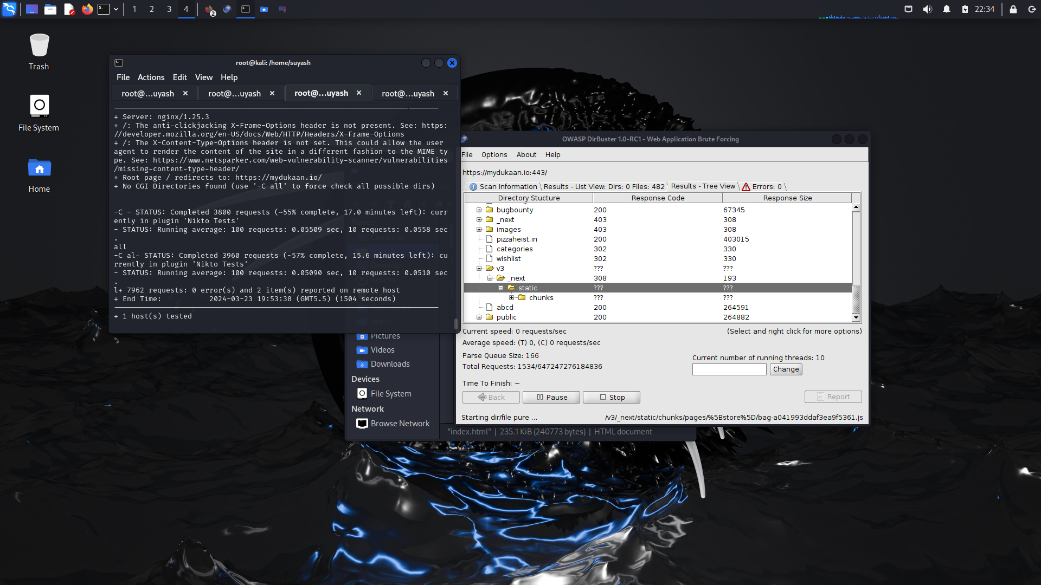
Evidence Tool used - Dirbuster
CMD - dirbuster https://mydukaan.io

Slide 14
References
https://owasp.org/www-project-web-security-testing-guide/latest/4-Web_Application_Security_Testing/02-Configuration_and_Deployment_Management_Testing/03-Test_File_Extensions_Handling_for_Sensitive_Information
https://pentest-tools.com/blog/detect-sensitive-data-exposure
https://knowledge-base.secureflag.com/vulnerabilities/sensitive_information_exposure/sensitive_information_disclosure_vulnerability.html

Slide 15
03
Test HTTP Strict Transport Security

Slide 16
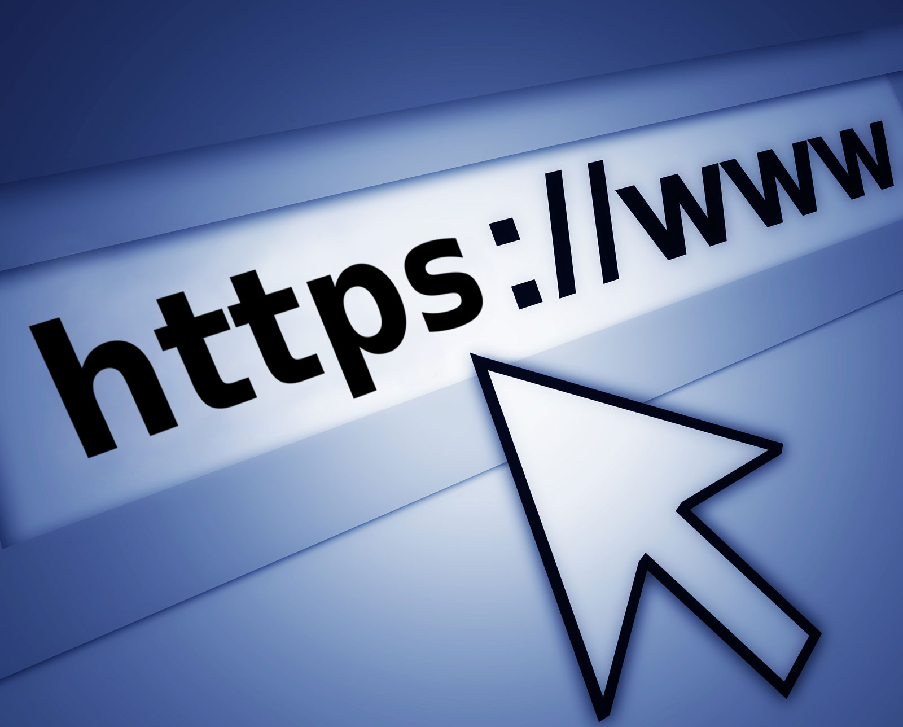
Description
A risk that the system will deny access to users when HSTS isn’t configured correctly.

Slide 17
Vulnerability Found:
1. The anti-clickjacking X-Frame-Options header is not present.
2. The X-Content-Type-Options header is not set. This could allow the user agent to render the content of the site in a different fashion to the MIME type.
3. More Vulnerability (Attach file ‘Vulnerability_1’)
Solution
Make sure that the property has a Redirect to HTTPS rule configured with the Redirect Status Code

Slide 18
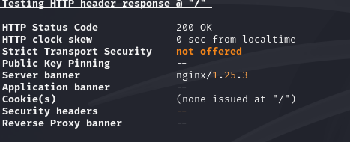
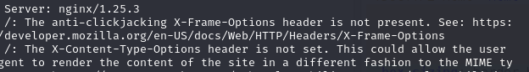
Evidence Tool used - nikto
CMD - nikto mydukaan.io

Slide 19
Reference
https://kinsta.com/knowledgebase/hsts-strict-transport-security/
https://techdocs.akamai.com/property-mgr/docs/http-strict-transport-security-hsts
https://developer.mozilla.org/en-US/docs/Web/HTTP/Headers/Strict-Transport-Security
https://en.wikipedia.org/wiki/HTTP_Strict_Transport_Security

Slide 20
04
Enumerate Applications on Webserver

Slide 21

Description
A classic problem is that clients do a fail-open when OCSP server does not respond in time, i.e. they treat the certificate as valid even if it was already revoked.

Slide 22
Vulnerability
Vulnerability Found
OCSP URI http://zerossl.ocsp.sectigo.com
OCSP stapling not offered
OCSP must staple extension --
DNS CAA RR (experimental) not offered
Certificate Transparency yes (certificate extension)
Solution
Test whether the server enabled OCSP stapling by default. The exact steps for doing this will depend on the type of server you’re using.

Slide 23
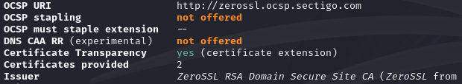
Evidence Tool used - testssl

Slide 24
Reference
https://hstechdocs.helpsystems.com/manuals/globalscape/eft7-4/mergedprojects/eft/ocsp.htm#:~:text=Thus%2C%20the%20absence%20of%20OCSP,revocation%20information%20from%20CA%20sources.
https://blog.cloudflare.com/high-reliability-ocsp-stapling
https://www.ssldragon.com/blog/ocsp-stapling/

Slide 25
05
Testing for Weak Transport Layer Security

Slide 26
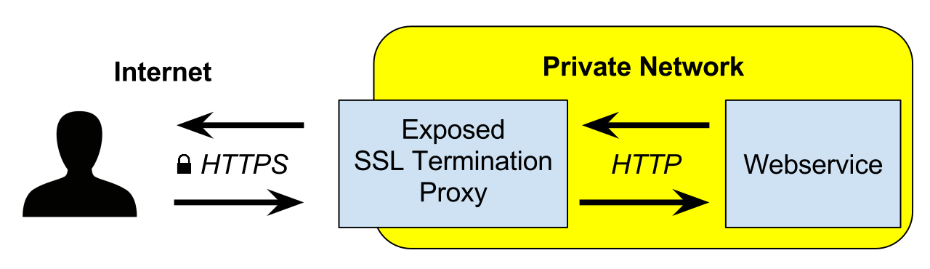
Description
The BREACH vulnerability allows attackers to discover secrets wrapped in HTTP compression inside of SSL. By injecting plaintext into an HTTPS request, an attacker can learn information about the corresponding HTTPS response by measuring its size.

Slide 27
Vulnerability
Vulnerability Found
BREACH (CVE-2013-3587) potentially NOT ok, "gzip" HTTP compression detected. - only supplied "/" tested
Solution
To mitigate this vulnerability, you can disable HTTP compression, or only enable HTTP compression for static content.

Slide 28
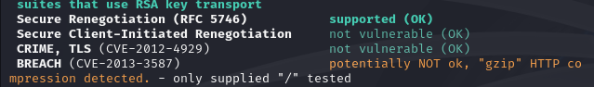
Evidence Tools Used - testssl

Slide 29
Reference
https://nvd.nist.gov/vuln/detail/CVE-2013-3587
https://cve.mitre.org/cgi-bin/cvename.cgi?name=CVE-2013-3587
https://www.cvedetails.com/cve/CVE-2013-3587/

Slide 30
06
Content Security Policy

Slide 31

Description
Content Security Policy (CSP) is an added layer of security that helps to detect and mitigate certain types of attacks, including Cross Site Scripting (XSS) and data injection attacks. These attacks are used for everything from data theft to site defacement or distribution of malware. CSP provides a set of standard HTTP headers that allow website owners to declare approved sources of content that browsers should be allowed to load on that page — covered types are JavaScript, CSS, HTML frames, fonts, images and embeddable objects such as Java applets, ActiveX, audio and video files.

Slide 32
Vulnerability
Vulnerability Found
Check the evidence
Solution
Ensure that your web server, application server, load balancer, etc. is configured to set the Content-Security-Policy header.

Slide 33
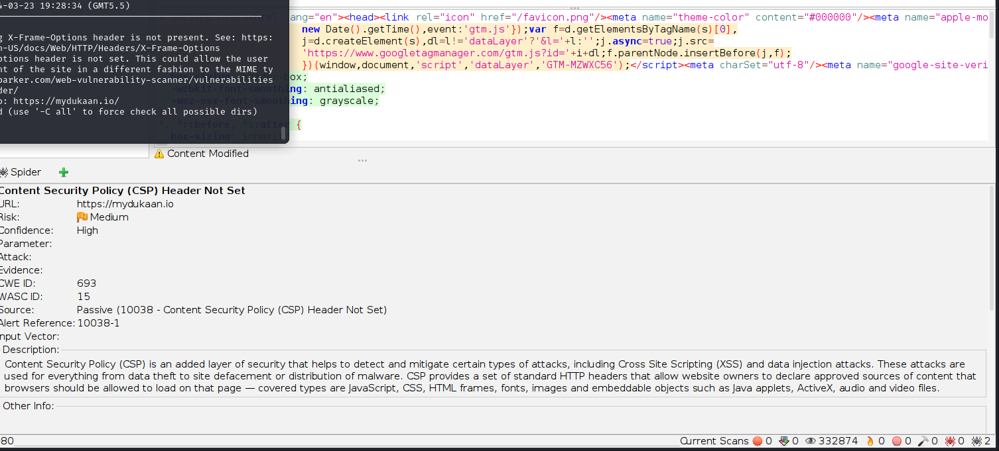
Evidence Tool used - ZAP

Slide 34
Reference
https://portswigger.net/web-security/cross-site-scripting/content-security-policy
https://www.imperva.com/learn/application-security/content-security-policy-csp-header/
https://developer.mozilla.org/en-US/docs/Web/HTTP/CSP
https://www.acunetix.com/vulnerabilities/web/content-security-policy-csp-not-implemented/

